Slide 1
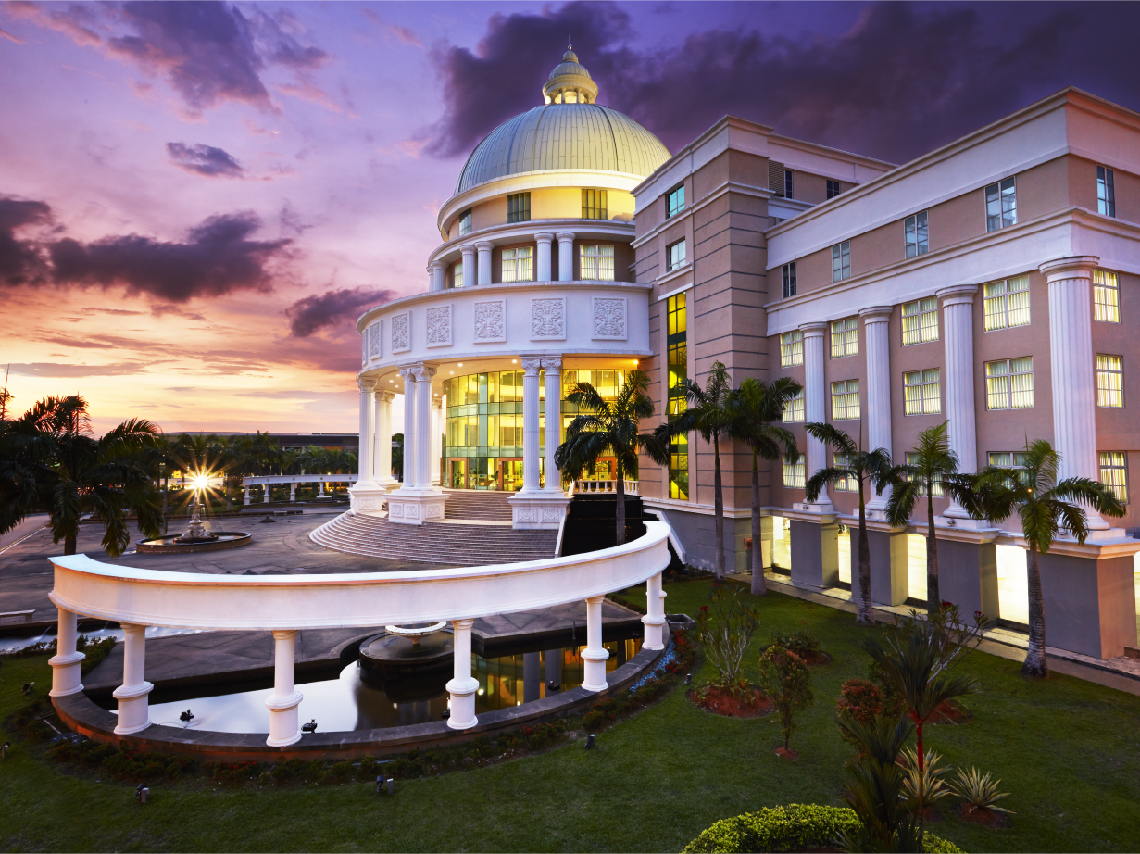

On-Campus Accommodation
SEGi Mars & Venus
&
Off-Campus Accommodation
SEGi Residences

Slide 2
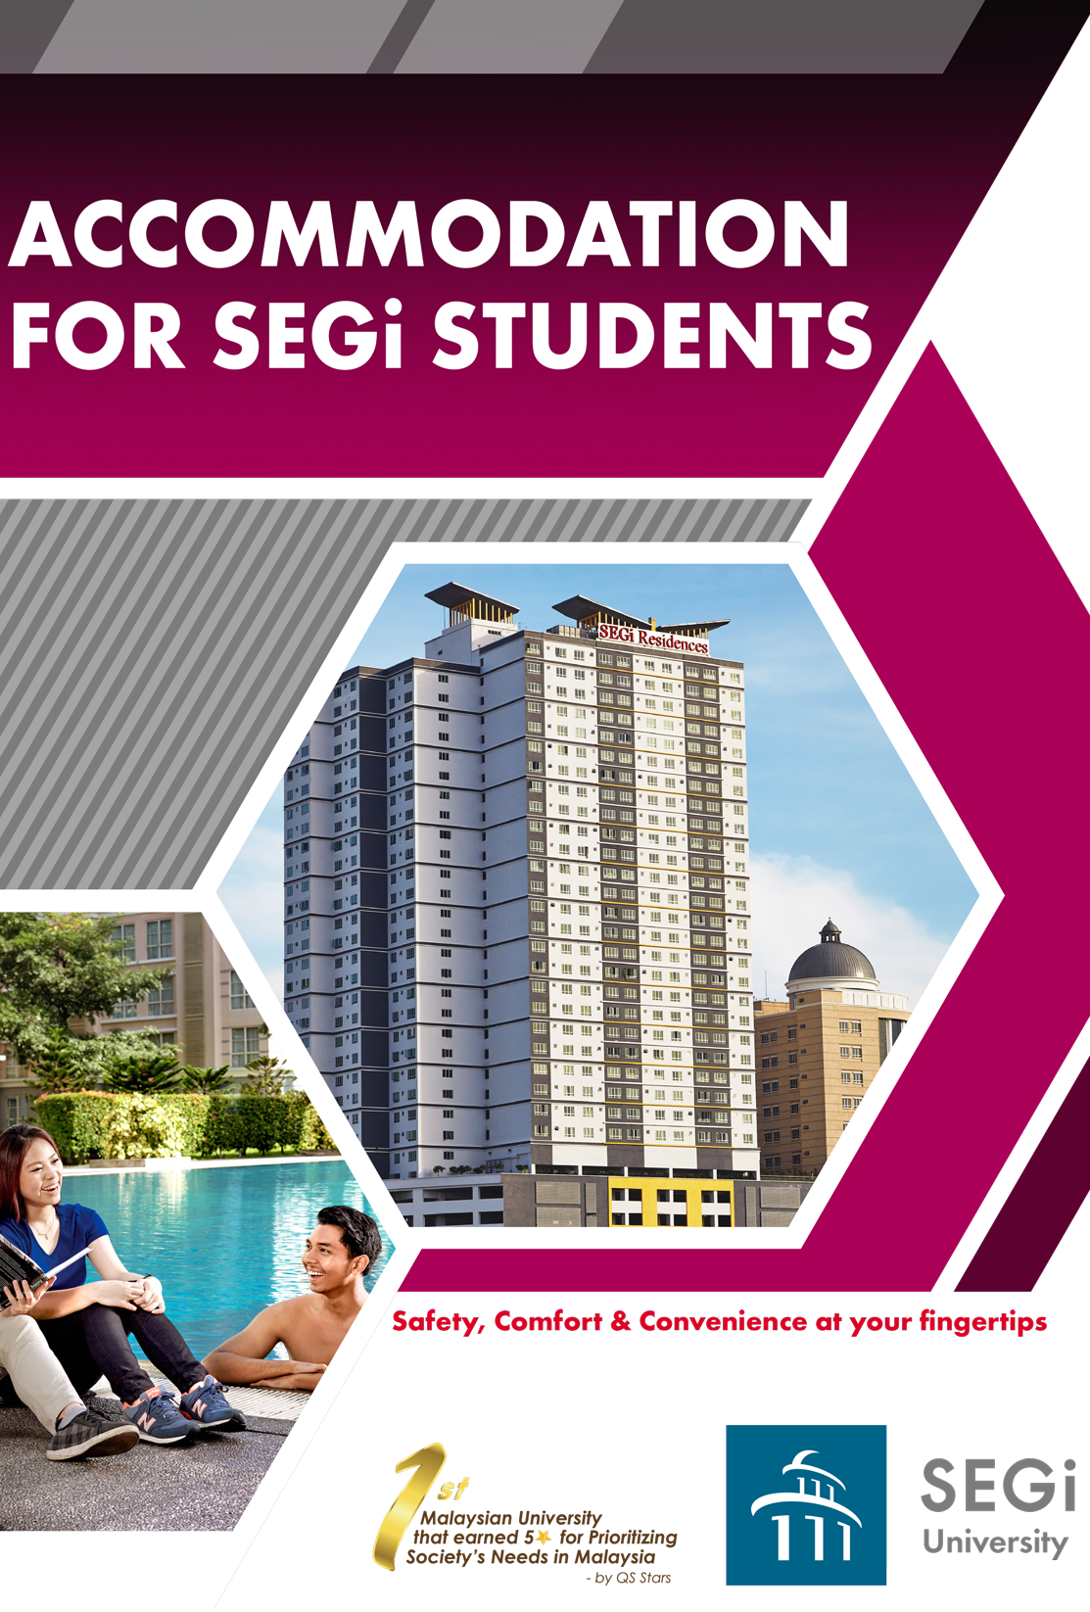
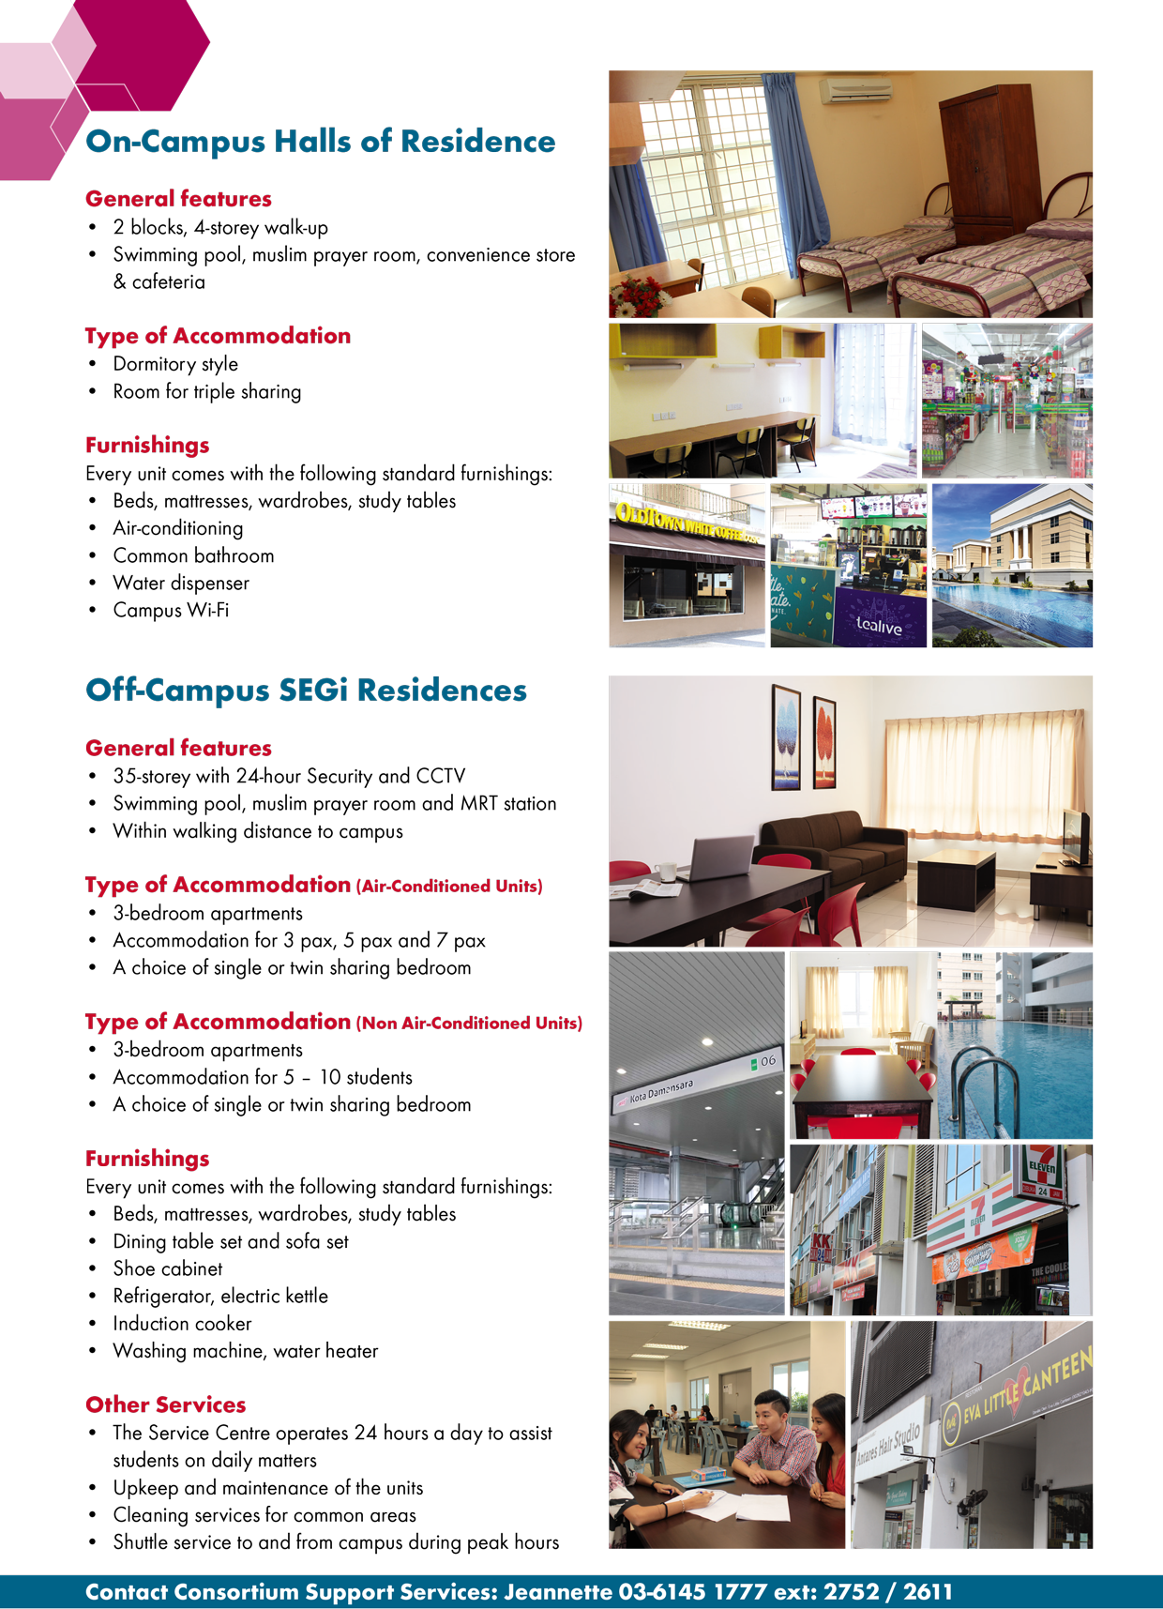

Slide 3

On-campus Accommodation
SEGi Mars & Venus
Off-Campus Accommodation
SEGi Residences
200 meter

Slide 4

Access from Entrance A MRT Station Kota Damansara
Covered walkway from Entrance A MRT Station Kota Damansara
Covered walkway from MRT Station Kota Damansara
Access from MRT Station No. 6 Kota Damansara
Entrance from Back Gate to SEGi University/ On-Campus Accommodation
Covered walkway from MRT Station Kota Damansara all the way to On-Campus & Off-Campus Accommodation

Slide 5
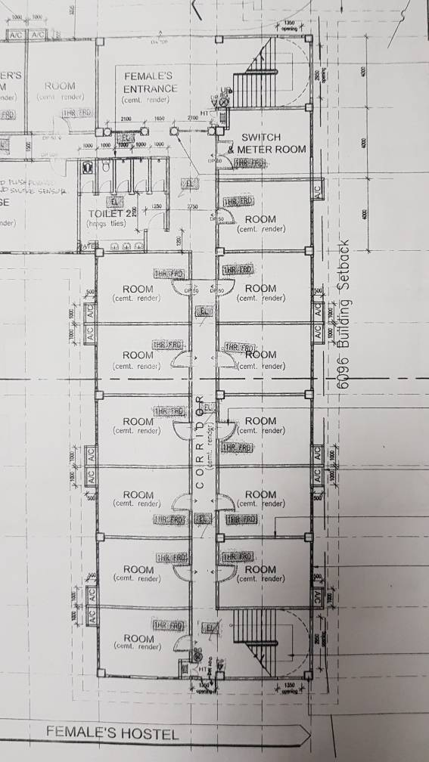
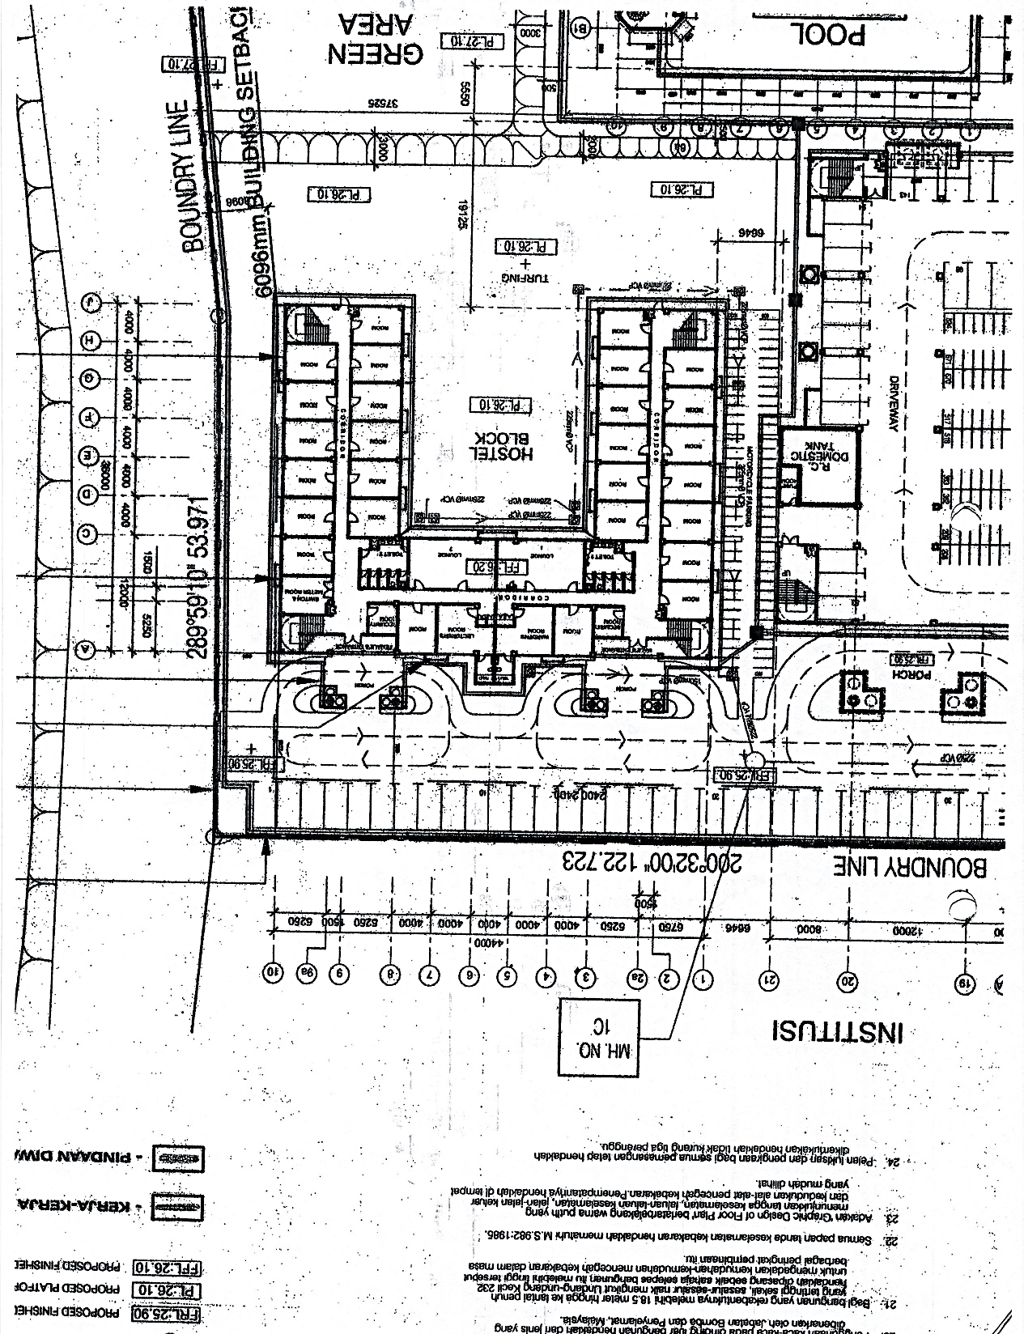
On-Campus Accommodation Floor Plan
Common
Bathroom
17 feet
13 feet
Mars
(Male)
Venus (Female)

Slide 6
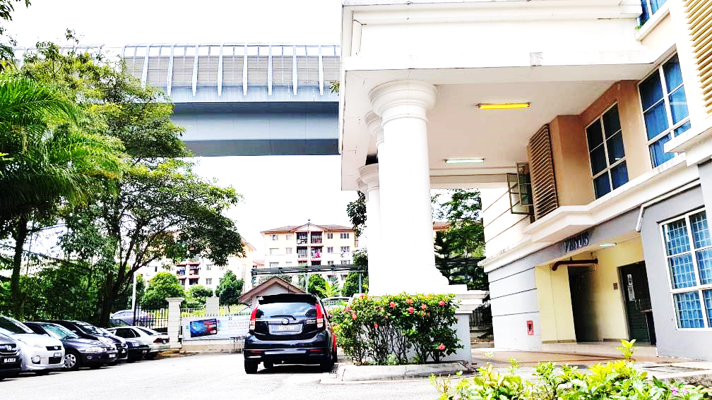
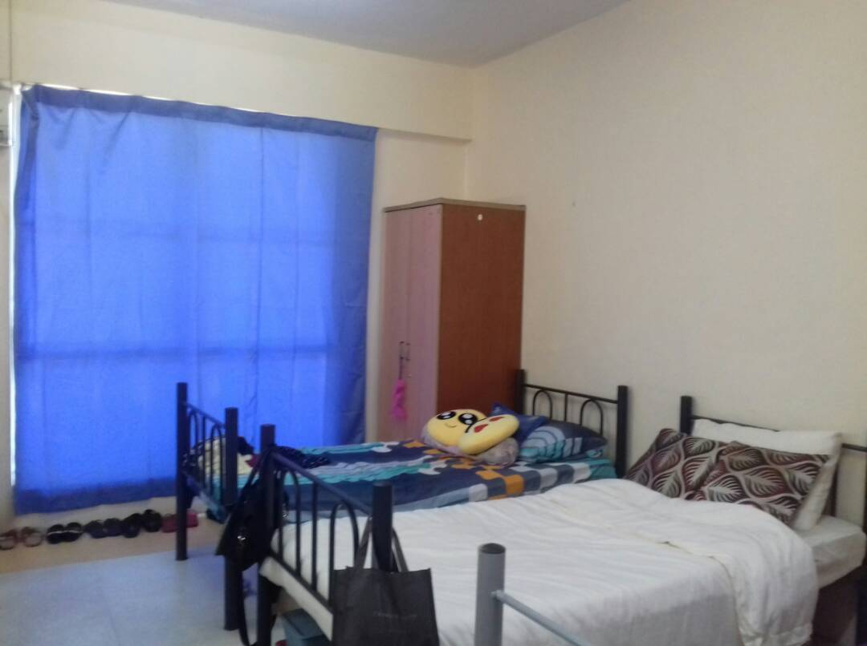
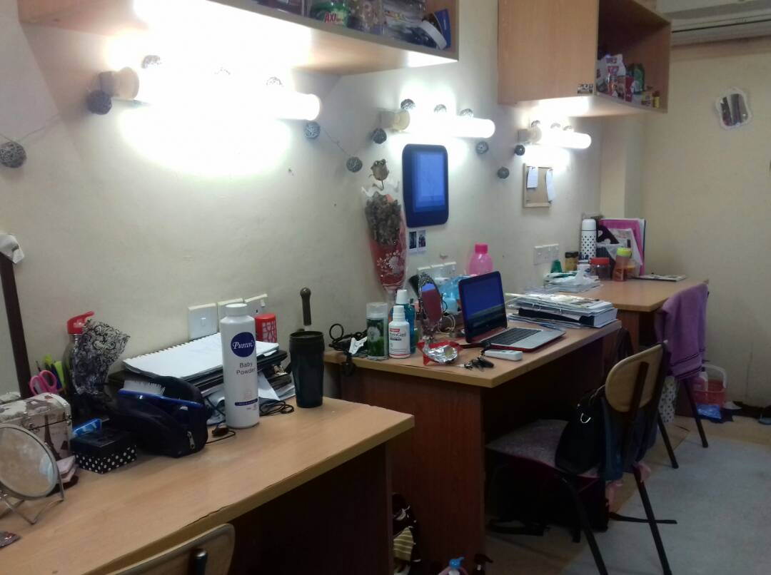
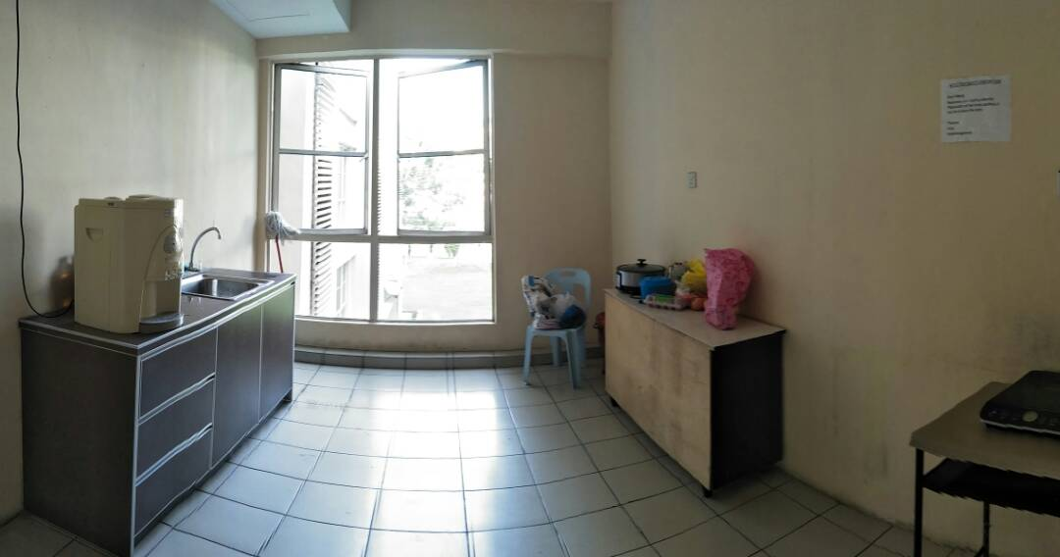
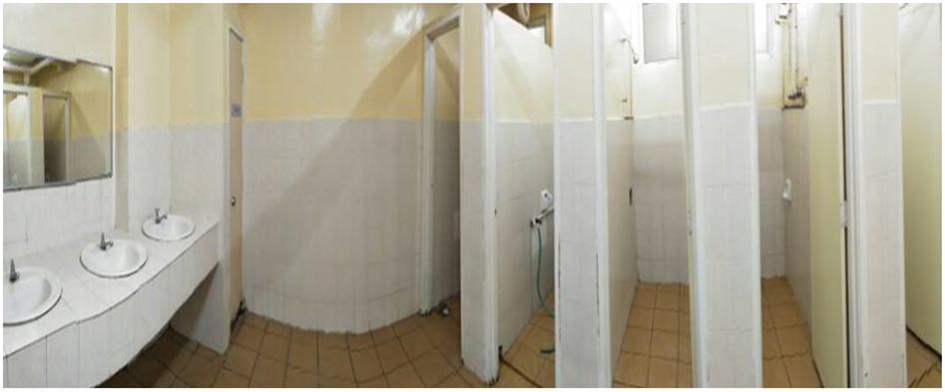
Room- Bed & Study Area
Common Pantry
Common Bathroom
Main Entrance

Slide 7
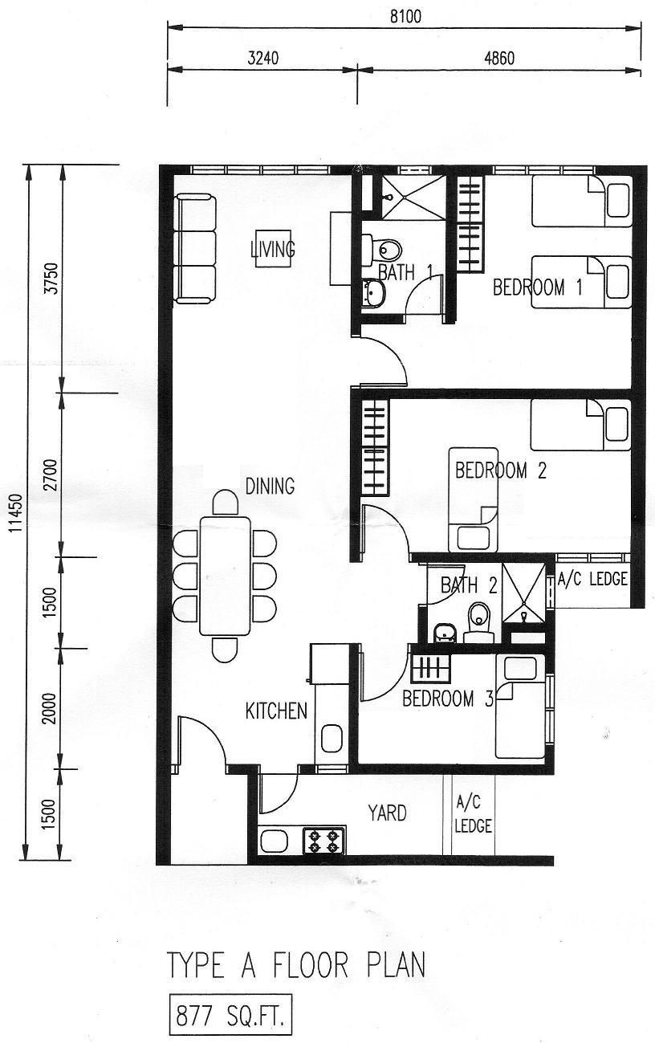
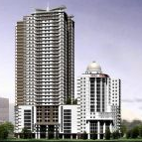
Off-Campus Accommodation Floor Plan – SEGi Residences
12 feet
12 feet
9 feet
7 feet
10 feet

Slide 8
